Slide 1
Sample Efficient Prioritized Experience Replay for Adversarial Environments
Tianyang Duan, Zongyuan Zhang, Zekai Sun, Heming Cui

Slide 2
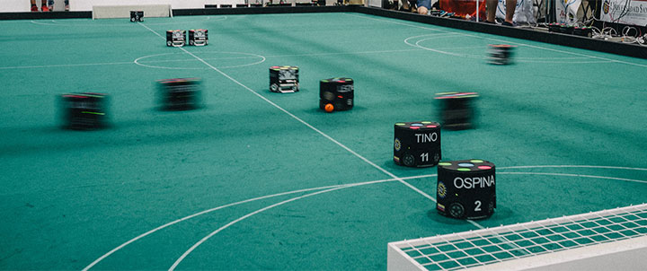
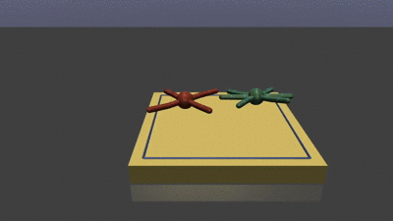
Motivation
Adversarial environment
Non-stationary environment
Zero-sum game
Rapidly changing conditions and unpredictable opponents
Reinforcement learning(RL) shows promising results in adversarial environments.
Learn through interactions between agents and environments.
Require a large number of trials and errors to converge
Sample efficiency of RL needs to be improved in adversarial environments.
Reduce the amount of data required for reaching target performance level.
Robot soccer
RoboSumo

Slide 3
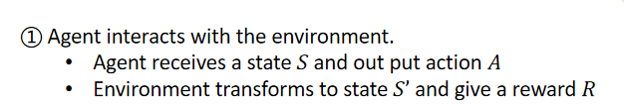
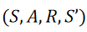
Experience Replay
Experience replay stores past experiences in a replay buffer and sampled randomly during training to improve the sample efficiency.
RL agent
Env
①
policy
②
③
Replay Buffer
② Store the transaction in replay buffer.
③ Sample a batch of transactions to train.
However, random sampling degrade sample efficiency, especially in non-stationary environments.

Slide 4
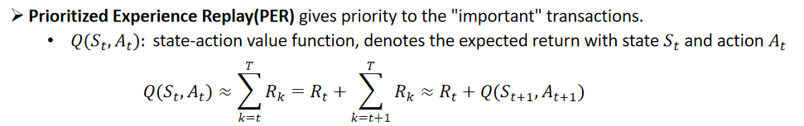
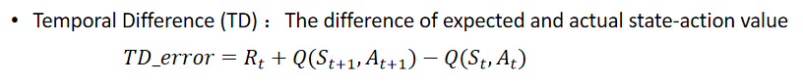
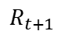
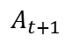
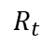
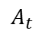
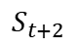
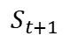
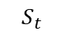
Existing Prioritized Experience Replay Method
A transaction
...
$$A_{t}$$
$$A_{t+1}$$
...
$$S_{t}$$
$$S_{t+1}$$
$$S_{t+2}$$
$$R_{t}$$
$$R_{t+1}$$
Priority is calculated based on the TD error of the transaction.
Why TD error: TD error reflects the degree of deviation of a sample from the policy

Slide 5
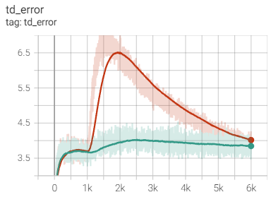
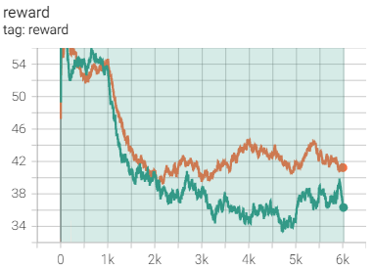
Problems of Existing PER Method in Adversarial Environment
Prioritized transctions at the edge of the state-action space(with high TD error) hinder the fast convergence of RL[1].
State-action space edge
High TD error
Changes in environment
In the later training stages, outdated samples are prioritized which introduce noise.
TD error
Reward
TD error cannot fully capture opponent strategy changes.
Environment changes at 1k step
Orange: motion friction
Green: opponent strategy change
Thus, TD-error based PER approach is not ideal for adversarial environments
[1] Cao, Xi, et al. "High-value prioritized experience replay for off-policy reinforcement learning." 2019 IEEE 31st International Conference on Tools with Artificial Intelligence (ICTAI). IEEE, 2019.

Slide 6
From Temporal Difference to Adversarial Difference
We introduce the concept of Adversarial Difference (AD) as a measure to compare the expected returns from old and new opponents.
Why AD:
TD indicates deviation of a transaction versus the same opponent
AD indicates deviation of a transaction versus the different opponent
We propose Adversarial Prioritized Experience Replay (APRE) based on AD.
For improving sample efficiency in adversarial environments
APRE faces the following challenges:
How to define old and new transactions
How to trade off between old and new transaction
new experience: limited amount, help quickly converge
old experience: improving stability, avoiding catastrophic forgetting and overfitting

Slide 7
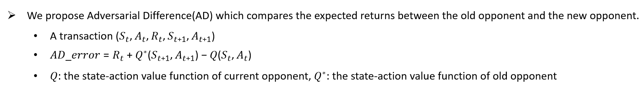
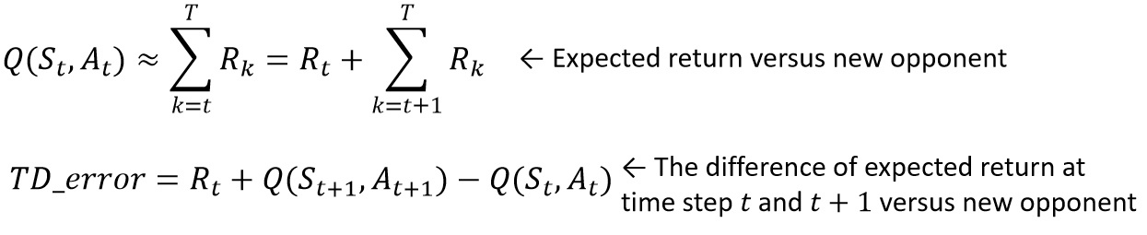
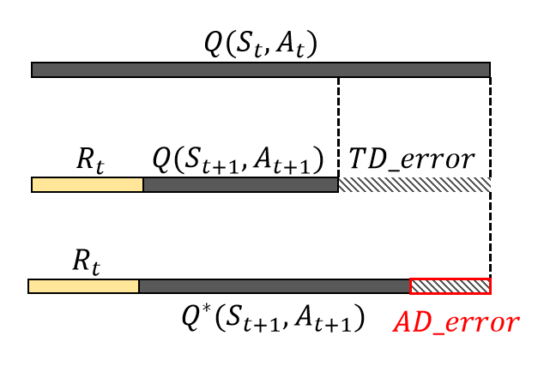
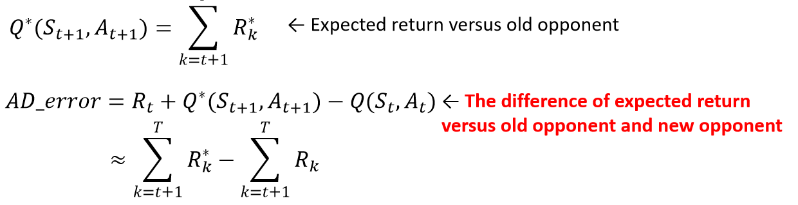
Key Idea: Adversarial Difference

Slide 8
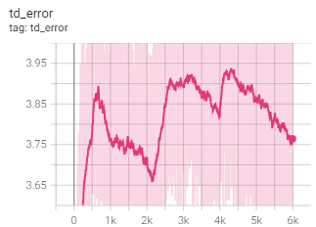
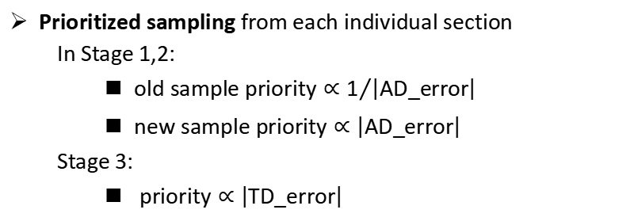
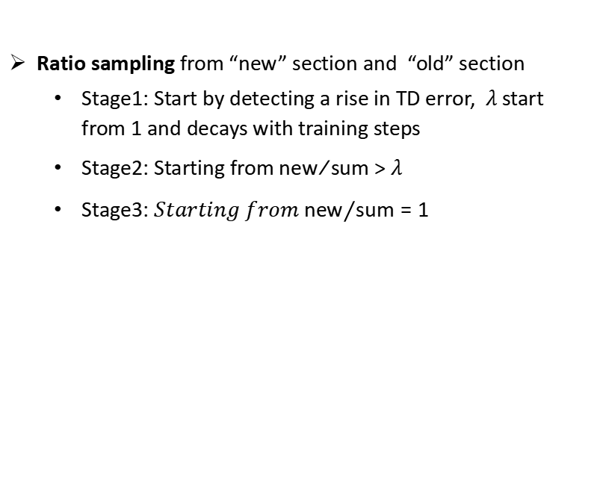
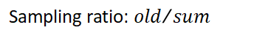
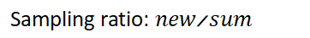
APER: Adversarial Prioritized Experience Replay
Ratio sampling from “new” section and “old” section
Stage1: Start by detecting a rise in TD error, $λ$start from 1 and decays with training steps
Stage2: Starting from ${new}/{sum }$>$λ$
Stage3: ${Starting from new}/{sum}=1$
The rise of TD error can be observed when the opponent change
Replay Buffer
Store a transaction
Stage 1
Old
Old
Old
Old
...
Old
New
New
New
Prioritized sampling from each individual section
In Stage 1,2:
$old sample priority∝1/{\left|AD_error\right|}$
$new sample priority∝\left|AD_error\right|$
Stage 3:
$priority∝\left|TD_error\right|$
Sampling ratio: 1-λ
Sampling ratio: λ
Stage 2
Old
Old
Old
...
Old
New
New
New
...
New
Sampling ratio: ${old}/{sum}$
Sampling ratio: ${new}/{sum}$
Stage 3
New
New
New
New
New
New
New
...
New
Sampling ratio: 1

Slide 9
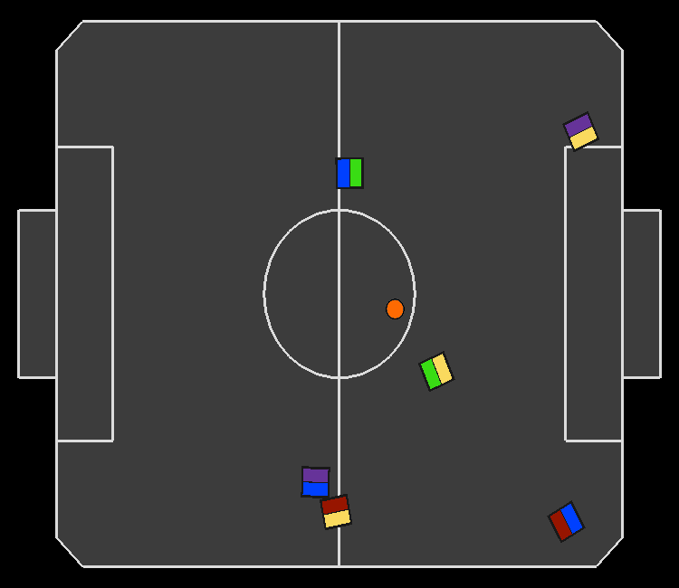
Implementation and Evaluation
Evaluation environment:
rSoccer - IEEE VSSS environment to simulate a robot soccer scenario.
RL algorithm:
TD3 (Twin Delayed DDPG): a state-od-the-art RL algorithm for continuous control tasks
Baseline:
Vanilla-ER
Prioritized Experience Replay (PER)
Combined Experience Replay (CER)
Evaluation settings:
3 vs 3 robot soccer match
Each agent controls one player
Follow the rewards shaping in rSoccer
Each match lasting 200 time steps

Slide 10
Evaluation Questions
Does the method improve sample efficiency in adversarial environments?
How does AD-error-based priority help to reduce the efficiency damage caused by outdated transactions?
What is the method's sensitivity to critical sampling-related hyperparameters?

Slide 11
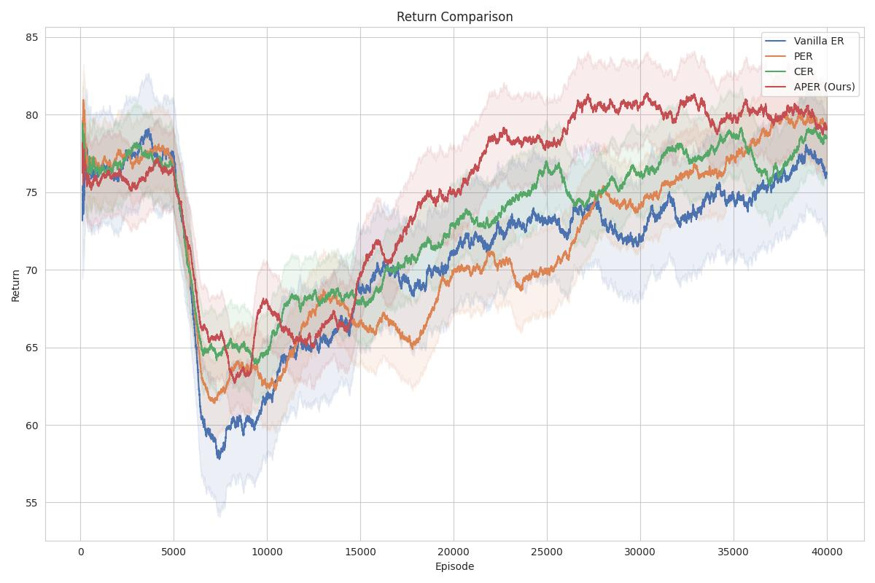
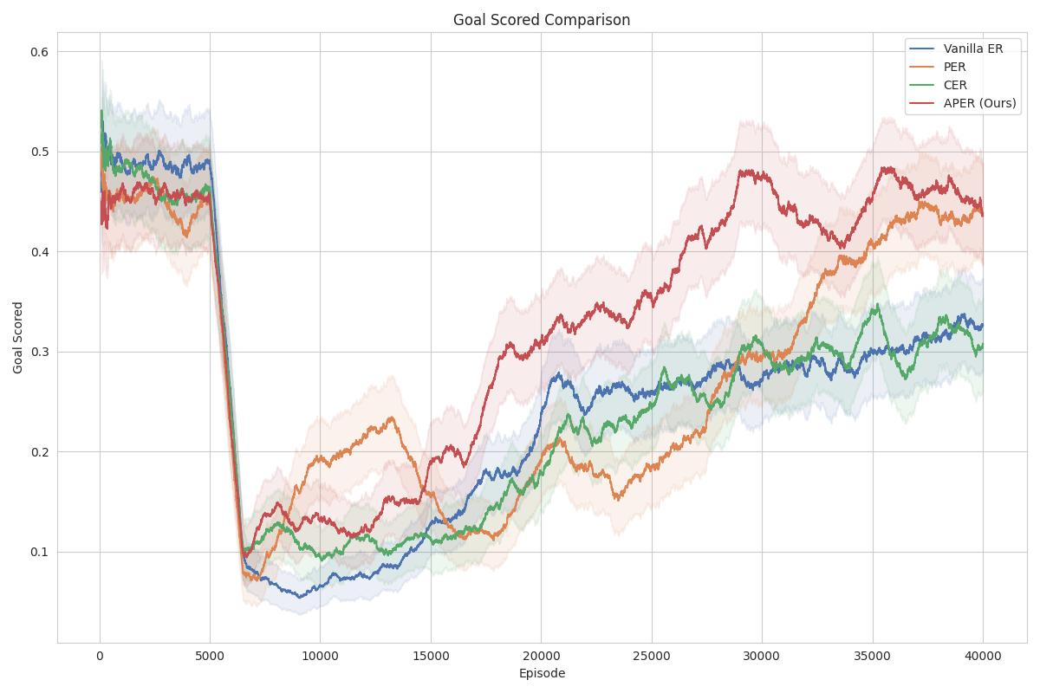
End-to-end Performance
Reward
APER (Red line) take a minimum of episodes to restore the average reward before changing the opponent policy, with a 46.64% improvement to Vanilla ER.
Play in the above experimental environment
At 5000 episodes, the opponent's strategy changed from offensive to defensive
All methods start from the same pre-trained model
All methods use the same hyperparameters, with learning rate = 1× 10⁻⁴, batch size = 1024, buffer size = 5 × 10⁵.
Goal
Replay | Episodes spent to restore the original rewards | Improvement over vanilla ER
APER (Ours) | 14695 | 46.64%
CER | 19698 | 28.48%
PER | 22064 | 19.89%
Vanilla ER | 27543 | -

Slide 12
Conclusion
In this talk, we present APER, a sample efficient prioritized experience replay for adversarial environments.
We propose adversarial difference (AD), which compares the expected gains between different opponents.
APER detects the changes of the opponent by the rise of TD error.
APER uses ratio sampling to trade off between the new transactions and old transactions.
APER samples from new and old transactions according to AD and 1/AD priority, respectively.
APER requires a minimum of episodes to restore the average reward before changing the opponent policy compared to baselines.
Plan to submitted to 26th European Conference on Artificial Intelligence (ECAI 23) in April.

Slide 13
Future work
Short-term work
Evaluate APER in other adversarial environments (e.g. RoboSumo, Pong)
Evaluate APER with other RL algorithms (e.g. A2C,DDPG)
Long-term work
Apply APER in real robotic multi-agent reinforcement learning environments
Experience replay sharing in distributed training
Apply APER in Deep Reinforcement Learning

